Slide 1
Project One: Air quality & covid-19
An exploratory study by Firdaus Mehta, Chao Wang & Litesh Samji

Slide 2
Project Outline
Our study is focused on identifying a correlation between developments in Covid-19 active cases and the changes seen in air quality across the world.
We will examine and visualise the air quality against the number of active Covid-19 cases in major cities around the globe, as well as 2 key cities in Australia from 2019 to 2020.
Hypothesis:
We expect to observe a strong, negative correlation between the number of Covid-19 active cases and the level of air quality, with more drastic improvements in air quality during the pandemic.

Slide 3
Research Questions
How do the changes in Australia’s air quality during the pandemic compare to the changes globally in the same time period?
Compare and contrast 5 major cities and their variation in air quality from 2019 to 2020?
Are the changes in the number of Covid-19 active cases correlated to the changes observed in Australia’s air quality in 2020?

Slide 4
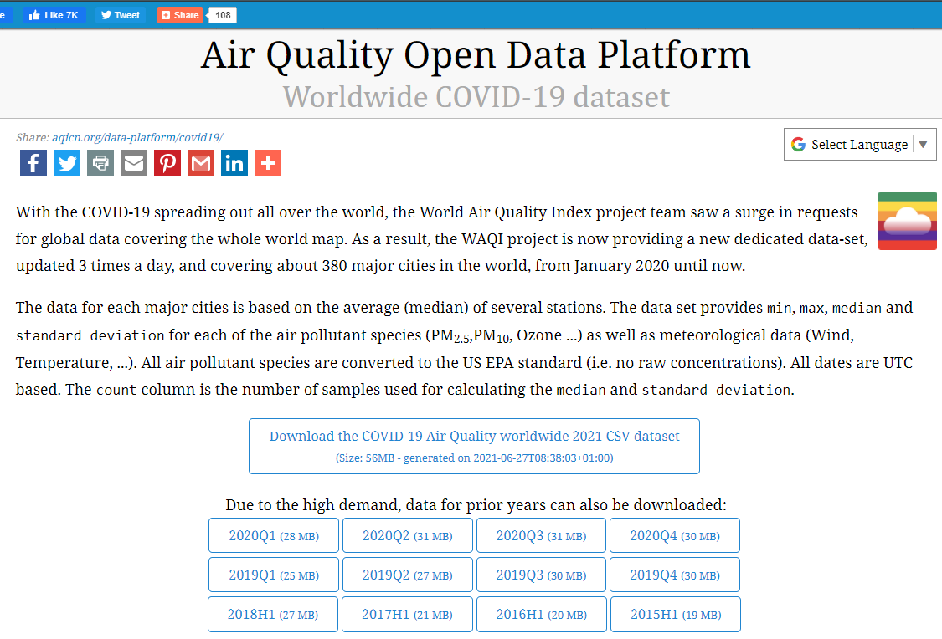
Where is the air quality data from?
https://aqicn.org/data-platform/covid19/
Notes:
Where did the data come from?
The air quality data is provided by the World Air Quality Index project team. The dataset provides min, max, median and standard deviation for each of the air pollutant species (PM2.5, PM10, Ozone, etc.) as well as meteorological data (Wind, Temperature, etc.).

Slide 5

Where is the Covid-19 data from?
https://covid19api.com/
https://www.kaggle.com/imdevskp/corona-virus-report
Notes:
https://api.covid19api.com/countries
The above api example covers the covid-19 data up-to-date. It also shows the number of confirmed, active, recovered, and death cases for each chosen country over the course of the current pandemic. Hence, we'll use this api to loop through the countries in our air quality data as well as to get the country name, country code and slug. The country code is used to merge with the air quality data (with country code only). The slug is later used to loop through the Covid-19 API by all case status for each slug (each country).

Slide 6
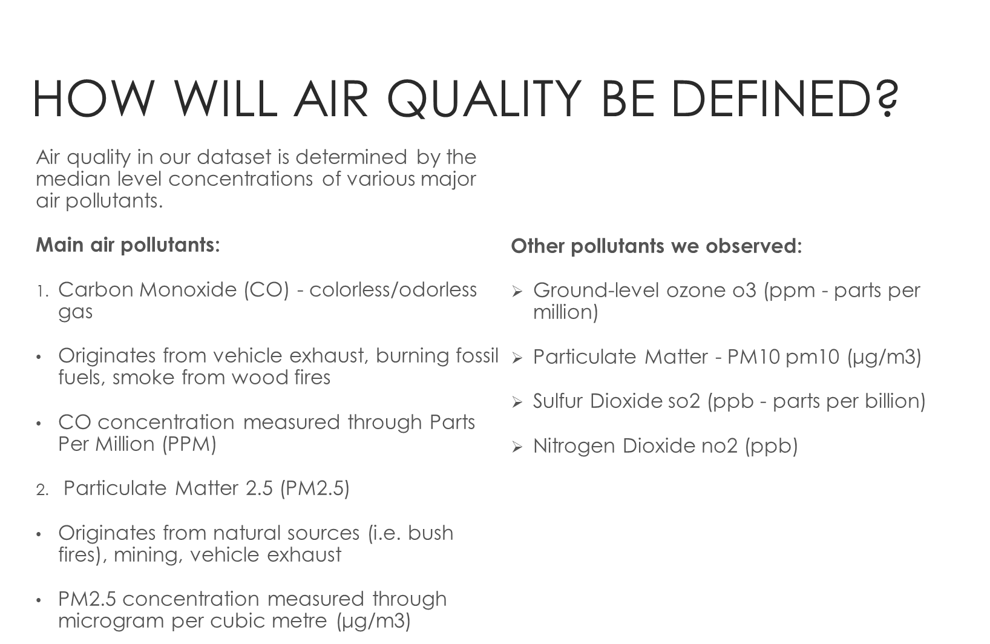
https://learn.kaiterra.com/en/air-academy/how-doesthelasereggmeasurepm2.5#:~:text=How%20Is%20PM2.,express%20the%20amount%20of%20PM2.
https://katestone.global/air-quality-covid-19-update2/

Slide 7

Data Exploration & Clean-up Process

Slide 8
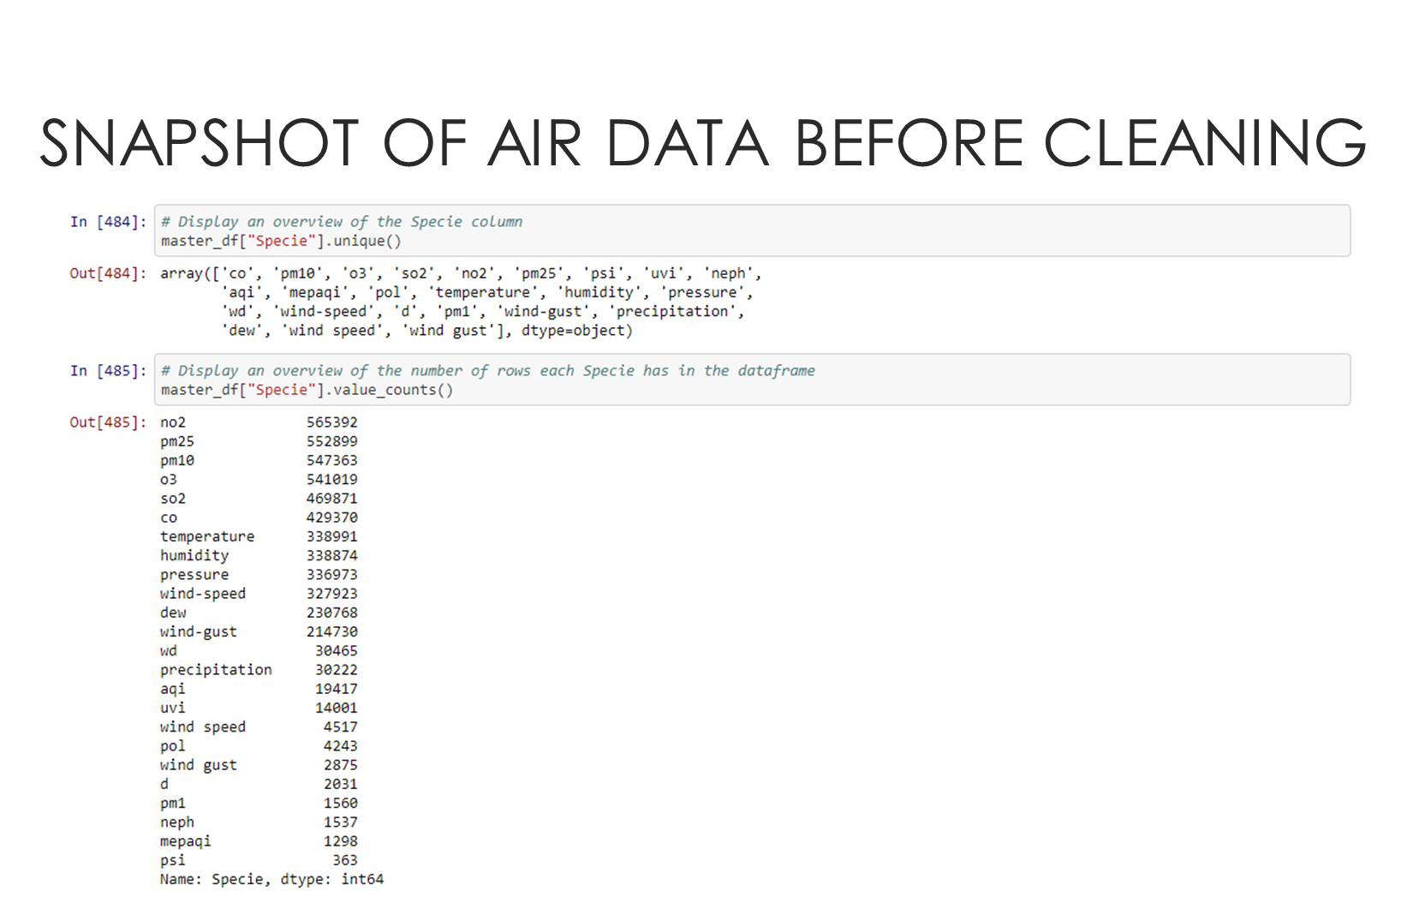
Notes:
From the websites we researched, and I showed you earlier, we understand that air movements affect the level of air pollutants. For example, if the air is calm, air pollutants cannot disperse and vice versa. Hence the Meteorology parameters like temperature, humidity, pressure, wind speed, to name a few, would have some sorts of correlations with the air quality.

Slide 9
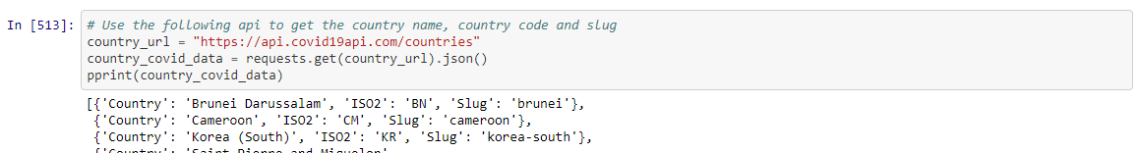
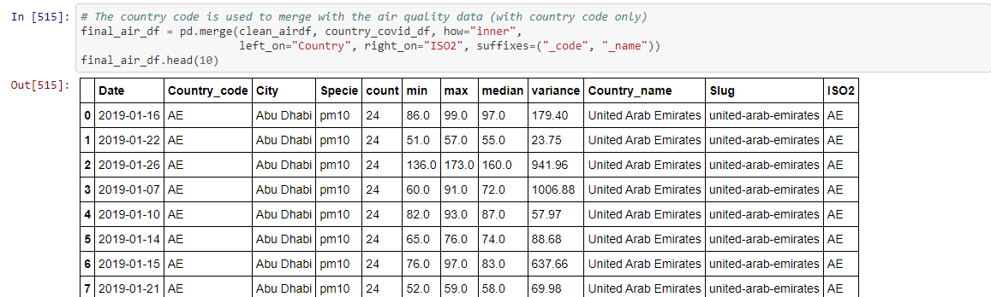
Getting the COVId-19 data
Notes:
However, due to the scope of our project, we'll only focus on air pollutant parameter because we're not actually trying to explain the causes of air quality change. And so we’ll remove data related to the meteorology-related species like temperature, humidity, pressure, wind-speed, dew, wind-gust, wind speed, wind gust, precipitation, wd (wind direction), uvi. We'll also remove species with the least number of available data points.

Slide 10

Analysis & Main Findings

Slide 11
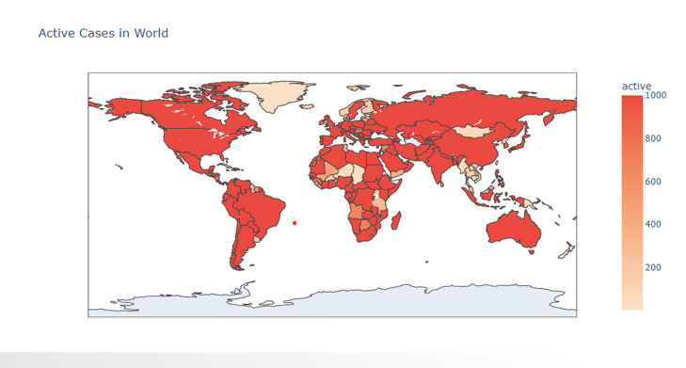
Total covid cases per 100 population
Notes:
https://www.kaggle.com/imdevskp/corona-virus-report
Research Dates 01/2020 – 07/2020
Daily Reports of COVID cases grouped by country

Slide 12
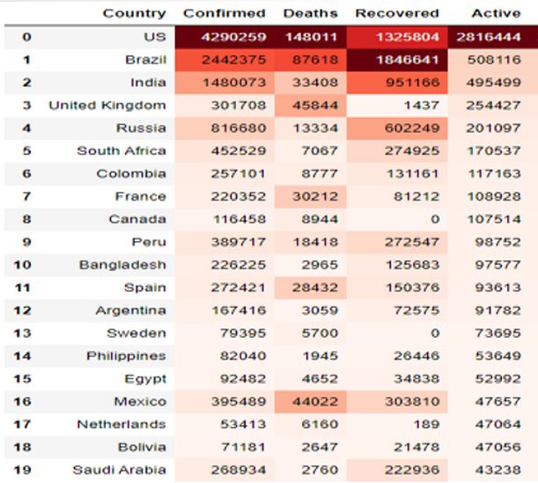
Total COVID counts per country
Notes:
Dates: 01/2020 – 07/2020
Top 20 countries in the world where COVID has been present

Slide 13
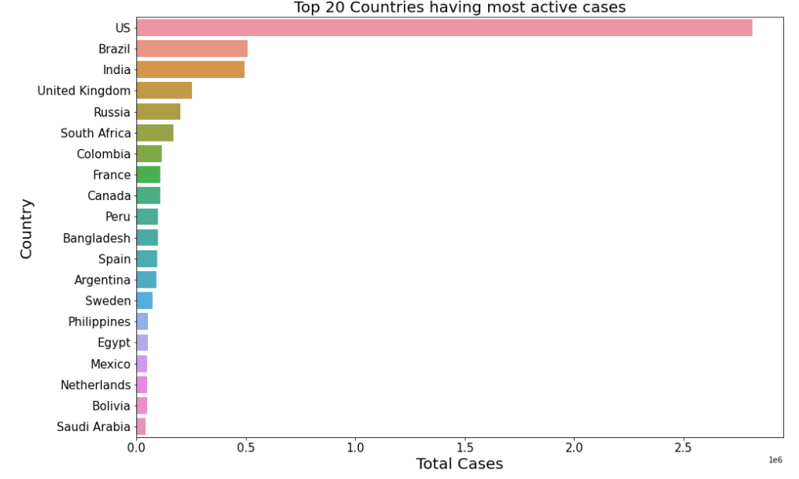
20 highest countries

Slide 14
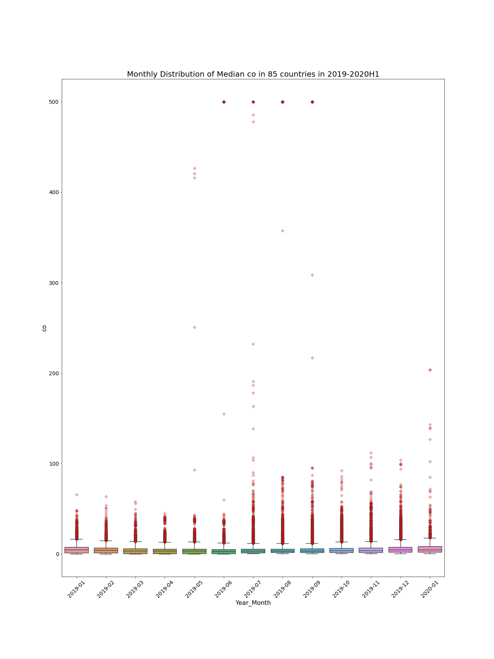
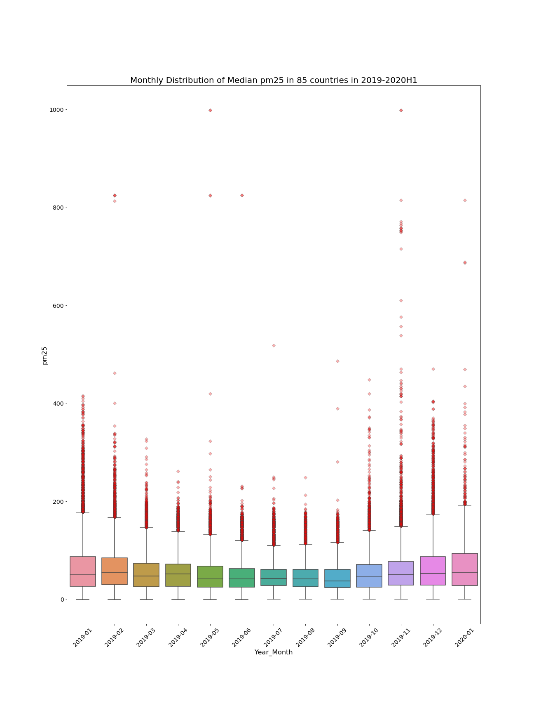
Notes:
As we can see from the above boxplots, there are quite a few extreme values in the median measurements However, due to our time and especially knowledge limitation regarding the air pollutants, we'll not remove any extreme values. We acknowledge these outliers would have some impact on our following analysis.
From the overview of the above boxplots, there seems to be no clear downward trend in the two main air pollutants throughout 2019 to 2020. There are some decreasing trends in the monthly distribution of median pm2.5 values from the beginning of 2019 to August 2019. However.
And around the same time when we can see CO levels start up pick up from July onwards.

Slide 15
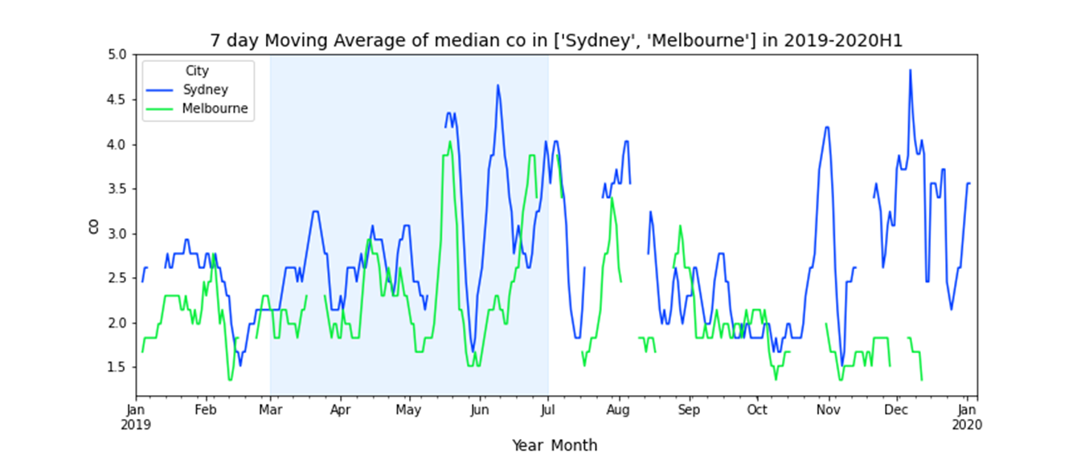
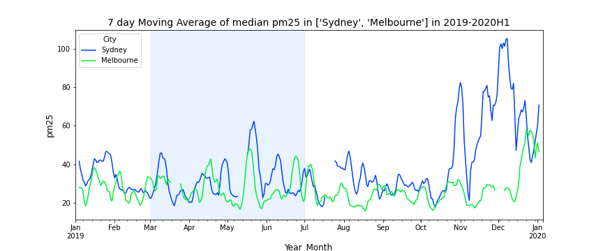
Notes:
As we can see For Melbourne and Sydney there is a major spike in co levels in between June and July which correlates with a similar spike in the monthly distribution of median co globally.
For Melbourne and Sydney, the particulate matter pm2.5 spiked significantly around the end of 2019. This would be explained by a series of massive bushfires raging New South Wales and Victoria during this time. The pm2.5 then dropped considerably into 2020.

Slide 16
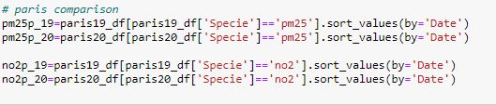
Data Process on PM2.5 and No₂ on 5 cities
Cities | Development | Population density
Pairs | High | Super High (21044/km²)
Brooklyn | High | High (14037/km²)
New Delhi | Medium | High (11050/km²)
Wu Han | Medium | Medium (2334/km²)
Melbourne | High | Low (516/km²)
Pollution major from construction and burning sources: PM2.5
Pollution major from traffic sources: No₂

Slide 17
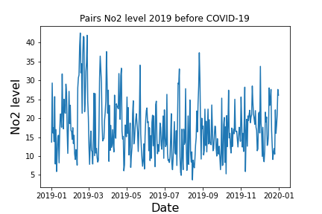
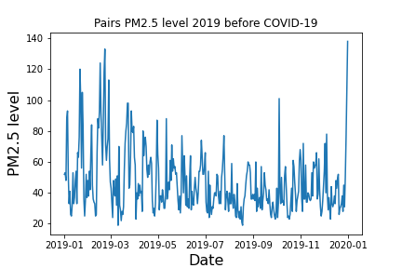
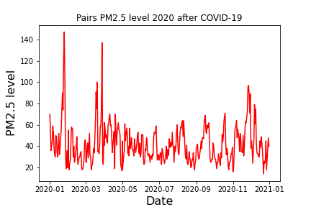
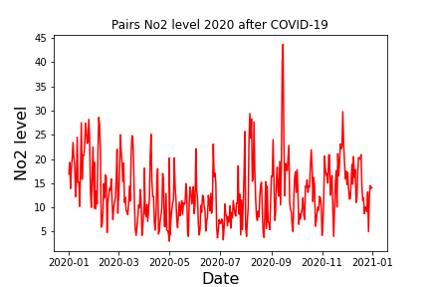
Paris

Slide 18
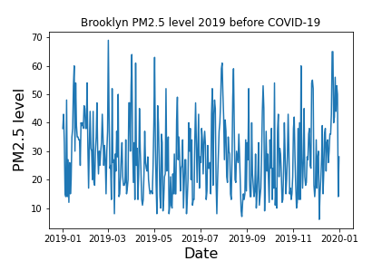
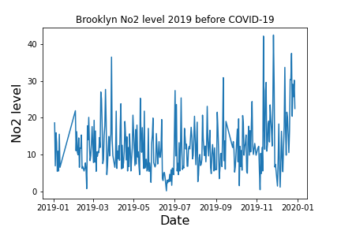
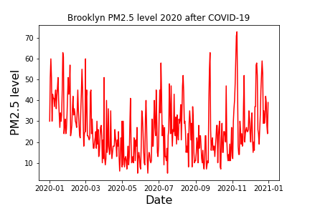
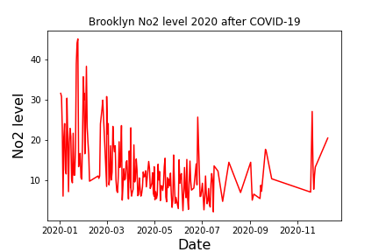
Brooklyn

Slide 19
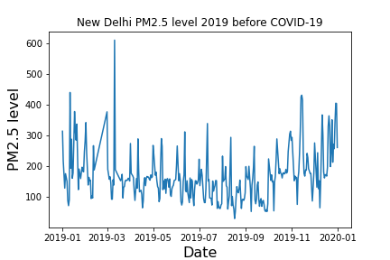
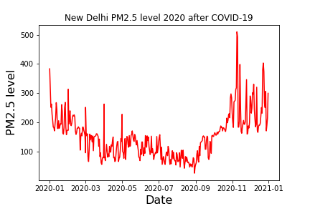
New Delhi

Slide 20
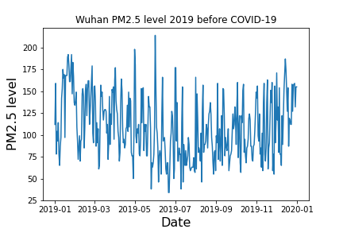
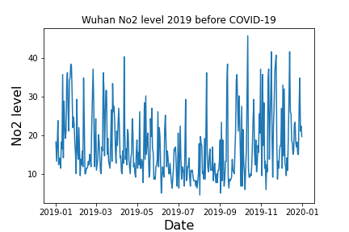
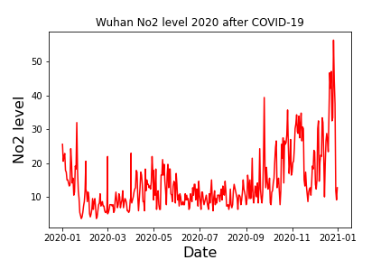
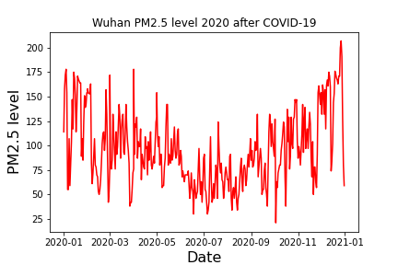
Wuhan

Slide 21
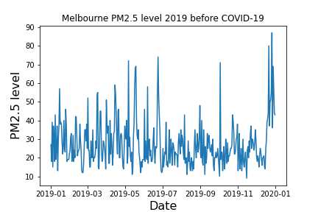
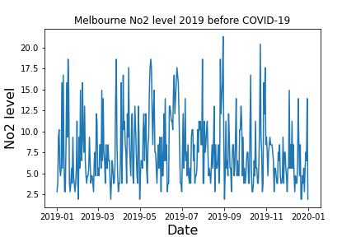
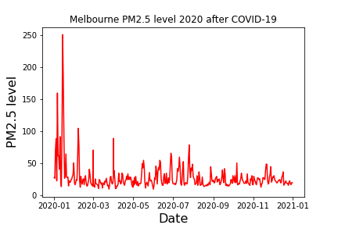
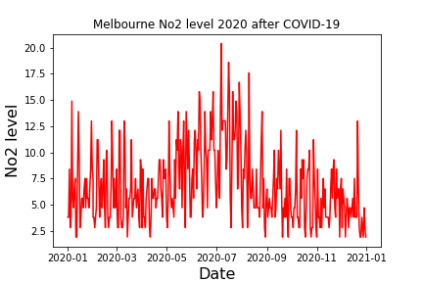
Melbourne

Slide 22
Summary value
Cities | PM2.5 2019 Before Covid | PM2.5 2020 After Covid | No2 2019 Before Covid | No2 2020 After Covid
New Delhi | 155 | 151
Paris | 40 | 38 | 16.4 | 12
Wuhan | 105.5 | 89 | 14.7 | 11.5
Melbourne | 24 | 23 | 6.5 | 5.6
Brooklyn | 27 | 24 | 10.9 | 10.4

Slide 23
Covid impact to cities
Covid generally improve the air quality for all cities
Higher impact on reducing in No₂ level than PM2.5, especially for more developed cities.
Data on air purification can tell a ‘true’ lockdown!
Cities from developing countries have large variation during Covid period

Slide 24

Limitations &
Future Considerations

Slide 25
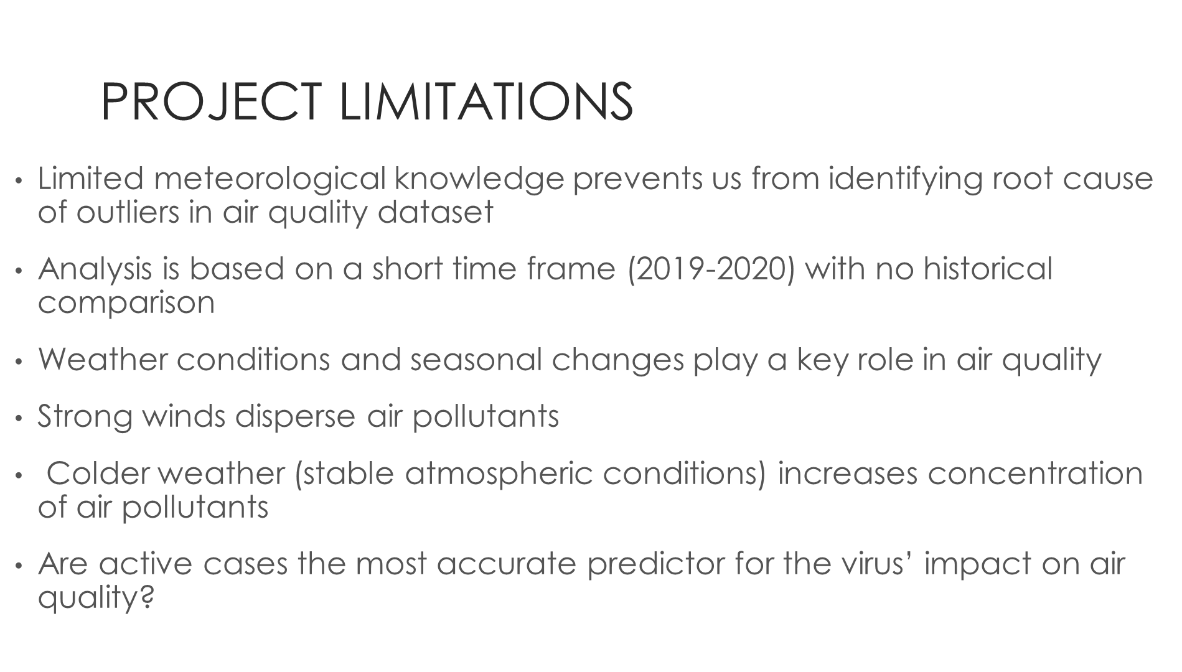

Slide 26
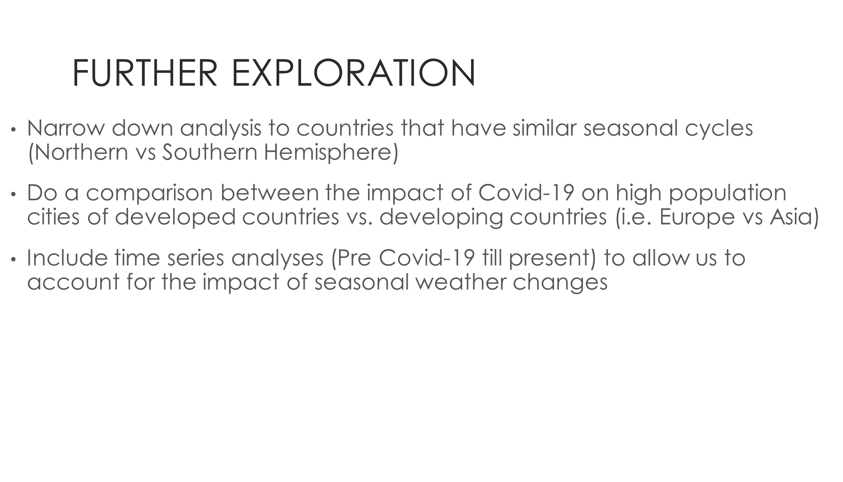

Slide 27


